Slide 1



CÉDRIC BERTRAND
ROXANNE SCHUMAKER
MAXIME LEJEUNE
DATA MANAGEMENT
PROJECT
GROUP 5

Slide 2

CONTENT
01
OUR INITIAL GOAL
02
WEBSCRAPING
03
DATA VISUALISATION
04
PREDICTION MODELS
05
CONCLUSION AND RESULTS

Slide 3
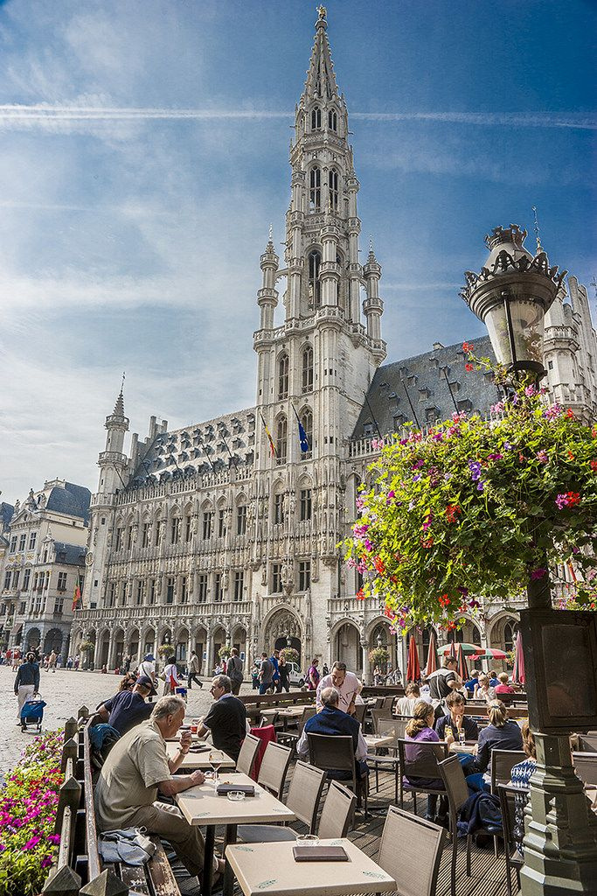



OUR INITIAL GOAL
We wanted to help owners predict their restaurant’s rating. We wanted to use our knowledge in webscraping and prediction models in order to get predictions about the restaurants ratings in Bruxelles.
Retrieving data about restaurants attributes that might influence the rating and trying to see what owners should expect as a rating for their restaurant depending on a few factors.

Slide 4



WEBSCRAPING
OUR FINDINGS
We were able to retrieve data about around 400 restaurants in the area of Bruxelles.
The webscraping script collected data such as restaurant names, locations, ratings, average budgets, maximum capacity and cuisine types.
We were able to add this data into a csv file that we cleaned in order to be ready for the models.
OUR ISSUES
While doing our webscraping, we found out that our first website "Yelp.be" had some restrictions for webscraping. We then found the website "trouvetonresto.be" which work.
We were able to retrieve a lot of data on this website but there was some data which we could not retrieve. This led us to less variables in our model.
There was also some unavailable data for some restaurants in the website. We decided to complete the dataset with the website "Tripadvisor.com".

Slide 5

DATA VISUALISATION
Average rating per type of cuisine
Average rating per average budget
WORLD
EXPENSIVE

Slide 6
PREDICTION MODELS
Types
Linear Regression & Decision Tree
OUR ISSUES
Quality of the predictions (MSE/MAE/R^2).
Solution : Decision tree
Hypothesis ==> lack of data about voting, subjectivity of ratings, .
Comparaison.

Slide 7



CONCLUSION & RESULTS
We, as business degree students, were able to retrieve data about an interesting subject thanks to webscraping and applying a model on this dataset.
We were unable to achieve consistent results, but we still have a model that can predict a restaurant rating.
DATA MANAGEMENT

Slide 8

THANK'S FOR WATCHING
CÉDRIC BERTRAND
ROXANNE SCHUMAKER
MAXIME LEJEUNE
GROUP 5
Link to our repository :
https://github.com/LejeuneMaxime/GroupProject.git

